Slide 1

BIRO Academy 2nd Residential Course
Plan to create a Diabetes Registry in Lebanon

Slide 2
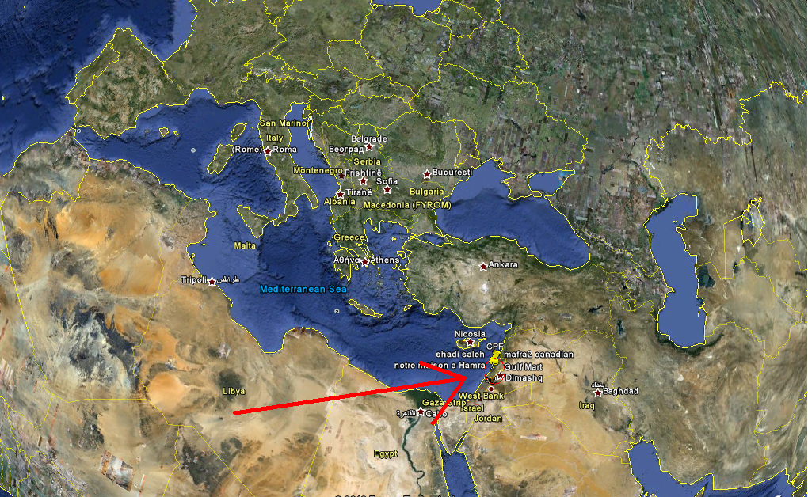

Slide 3
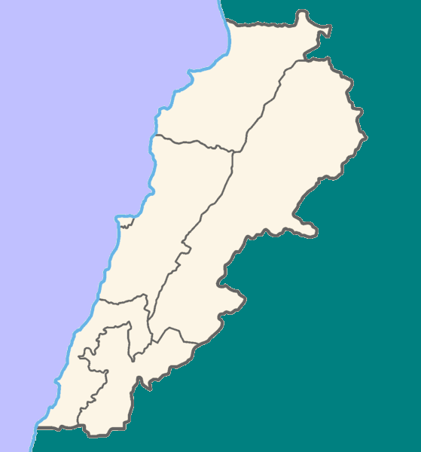

Slide 4
Lebanon
Arab Country
Mediterranean Sea
10400 Km2
4 million inhabitants
6 governorates

Slide 5
Diabetes in Lebanon
Private and public health system delivery and Military.
Estimated that 50% go to the public and 50% go to the private sector
The Prevalence of Newly diagnosed diabetes is estimated at around 13.4% in Women, and 17.6% in men
IFG is 9.8%

Slide 6
Diabetes in Lebanon
A study with the Italian corporation has shown that (before intervention):
75% HbA1c poor control, 10% good control, 15% fair
Microalbuminuria 70% poort,15% Good, 15% fair
Random Blood Glucose: 65% poor, 25% good, 10% fair

Slide 7
Diabetes in Lebanon
Misconception is prevalent leading to the poor control
(habits, education, believes, compliance)
Example: Insulin Fobia
Need to educate MD in rural
Lack of coordination between the health system and the MD delivering care

Slide 8
Diabetic Care delivery
Hospitals
Endocrinologists clinics
GP clinics

Slide 9
Disparities of Care
Care delivery in urban areas is much different than in rural areas
For example: the majority of amputations are done in the rural areas

Slide 10
Documentation helps
Results from a study in collaboration with the Italian Corporation on documenting diabetes care has lead to:
Discovering previously unidentified heart conditions, hypertension, kidney disorders, foot lesions

Slide 11
End results from the Study
2 Main indicators
HB1ac improved 23%
Micro Albuminuria improved 36%

Slide 12
Diabetic Patient Card
There is proposal for the ministry of health to create a health card for each diabetic patient:
Identification code
Demographics
Treatment
Treating center

Slide 13
CookBook
1: The Objective of the Registry:
Long term: Surveillance system for diabetic situation (prevalence, quality of care, indices)
Short term (3 years): By showing that it works motivate stakeholders

Slide 14
Objectives
Long-term : Will include 10 governmental hospitals, private clinics (endo and GP), and health delivery centers. Army Hospital
Short-term : Enlist the help of the Lebanese Diabetes Society (IDF member) to start the collection of data at a small scale (in collaboration with the ministry of health)
Maybe use the Army health network

Slide 15
Long term
Lebanon is organized into 6 governorates
  1 governmental hospital per governorate , 3 in Beirut
Each governorate is organized into 6 areas (Kada)
  Each kada has MD head of division
  Responsible to report to the governorate hospital

Slide 16


Slide 17
Hierarchy
Head of division, report to the governorate hospital
Then hospitals report to the National Diabetes Program,
That in its turn will report to the Ministry

Slide 18
Diabetes Registry
Could use this hierarchy in building and reporting to the registry.

Slide 19
II results
Long term:
  Numbers change over time
  Indicators and quality of care
Short term:
  Existence of registry
  Feasibility

Slide 20
III Acceptance
Enlist the support of the ministry of health
Lebanese Diabetes Society
Army Medical Care officials
Latter stage:
Hospitals
Heads of divisions
Physicians
Nurses

Slide 21
III acceptance
Supporters:
Pharmaceutical companies
NGO
International Organizations
University research centers
Media

Slide 22
Competitors
In Lebanon all Type I patients are treated at the Chronic Care Center
The center in fact has great potential to be one of our most enthusiastic supports if we have the right approach,

Slide 23
IV: Data
Data stake holders:
  Governmental authorities
  Hospital human resources
  Private clinics
  Head of divisions
  Diabetes National program
  Patients

Slide 24
IV data
Where do data come from:
Short term:
  Private clinic of members of the LDS
  Army medical records ?
Long term:
  9 governmental hospitals
  Head of divisions
  Army hospital
  Endo private clinics
  GP private clinic
  Chronic Care center for type I

Slide 25
V legal issues
Lebanese laws will be reviewed
Confidentiality is a must
Security of data thru a protocol that will be developed
Special care to data from army

Slide 26
VI what is Needed
Short term:
  A group of enthusiastic Endo from the LDS
  Nurses for data collection,
  Project coordinator ?
  Data sheet specially designed
  Software for data entry (SPSS, Access, Excel)
  Laptops
  Data analyst (Project coordinator)

Slide 27
VI what is need:
Training:
  Model exists created during the study in collaboration with the Italian Corporation (governmental hospital, NGO dispensaries, primary health care)
Material:
  Printing and coping of data sheets

Slide 28
VII Who does what
Short term: NGO LDS would take charge of initiating the system
Long term: discussed the role of Heads of divisions, hospitals, and National Diabetes Program
Still need to identify who owns the data, who generates reports,

Slide 29
VIII Who exploits the information
To whom the report will be delivered ?
Ministry
International organizations (WHO)
IDF (MENA region)
Order of physicians (endo society)
Media (for education purposes)
EUBIROD

Slide 30
Final thoughts
The experience with the Italian corporations has the opportunity of replication with the Belgium embassy in South Lebanon
Encourage the IDF to organize a series of workshop in Diabetes registries in region (MENA)

Slide 31
Thanks to
Vivie Traynor
Simion Pruna
Massimo Benedetti
Klaus Piwernetz
Fabricio Carinci
EUBIROD officials and speakers
EU commission

